Slide 1
DVB-S2/X
Block Party!
Hosted by
Phase 4 Ground

Slide 2
Who are you?
W5NYV
MSEE Information Theory from USC
Active in IEEE Information Theory Society
Co-founder of Open Research Institute
Lead of Phase 4 Ground
DVB-S2 and DVB-S2X are central technologies
The receivers need to be in GNU Radio
The hardest part is considered to be LDPC decode

Slide 3

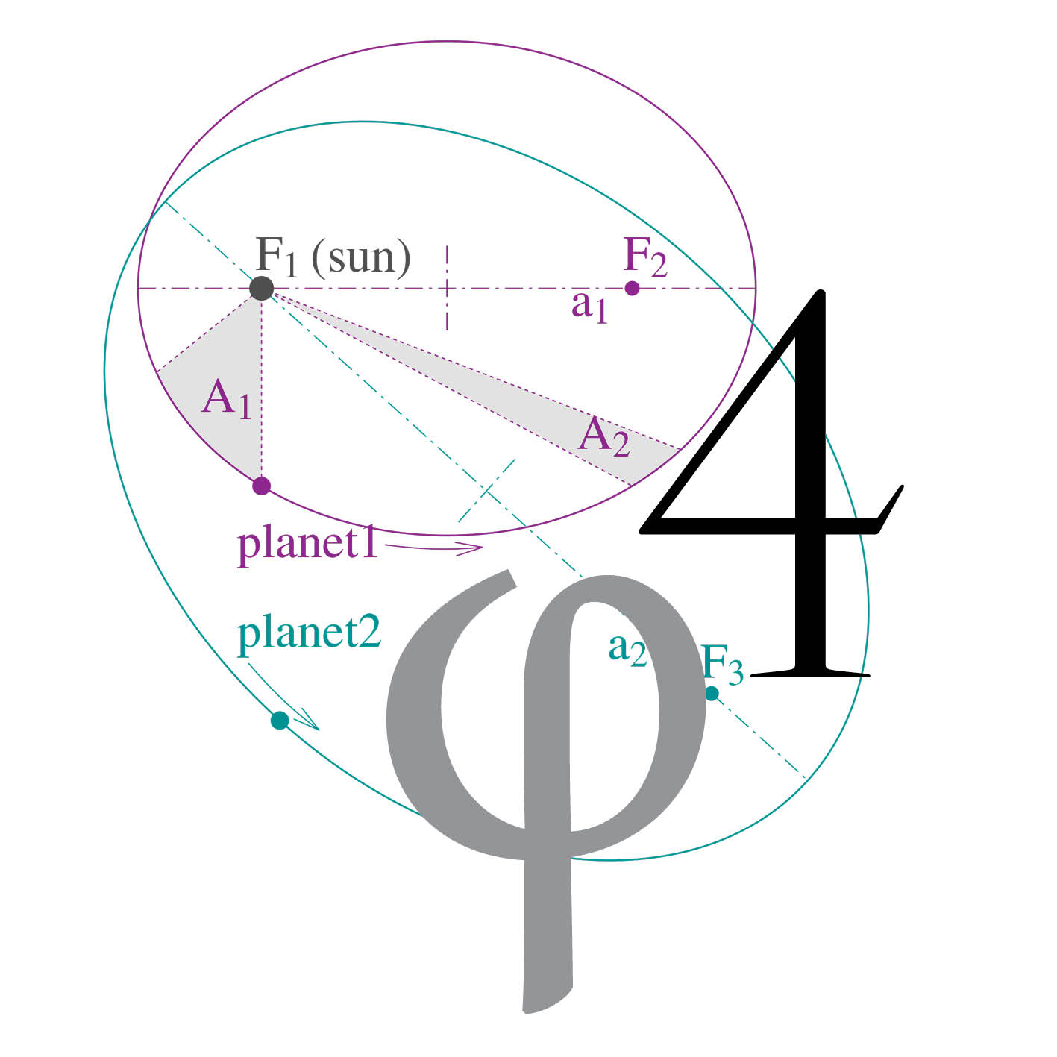
Who are we?
Open Research Institute, Inc. (ORI) is a non-profit
research and development organization
which provides all of its work to the general public
under the principles of Open Source
and Open Access to Research. openresearch.institute
Notes:
We are Open Research Institute, a non-profit incorporated in California in March 2018. We have applied for 501c(3).
ORI was founded by myself, renowned open source activist Bruce Perens, and the President of GNU Radio Foundation Ben Hilburn, in order to provide a structure for the open source work we were all already doing and were interested in supporting.
We are a new organization. We are not new at what we do.

Slide 4
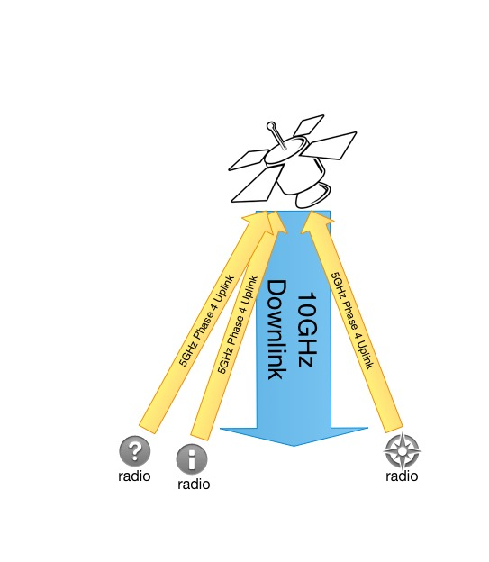
Phase 4 radios
5.645-5.655 GHz up
10.45-10.46 GHz down
MSK channelized uplink
DVB-S2/X downlink
Amateur space and
terrestrial sub-bands
are right next to each other.
Notes:
DVB-S and DVB-S2 is the most widely used communications standard for the downlink for broadcast satellite television. The transport layer, or the part of the protocol that is delivering broadcast content, is usually MPEG video. We don’t want to be limited to MPEG video for an amateur radio system. MPEG is great for video. There’s a way to carry general data within the MPEG stream, but it’s not very efficient or elegant. Fortunately, this is a solved problem. There’s a protocol from DVB written and ready to go called generic stream encapsulation, or GSE. GSE replaces MPEG. Using GSE as the transport stream protocol in DVB-S2 turns it into a very useful digital pipe, capable of supporting lots of simultaneous users transmitting and receiving all types of data, from live voice, to voice memos, to images, to video, to files, to whatever your station supports. That’s what our downlink looks like.
The uplink is a channelized part of the spectrum, in our case 5GHz. The frequency division multiple access uplink is received by a polyphase filter bank, the streams are received and processed, the ones that will be retransmitted are combined and multiplexed into a time division packetized format, and that entire signal is transmitted as one “pipe” using DVB-S2/X on the downlink. Managing this multiplexing is a big job and requires careful protocol design.
Uplink channelization can be changed on the fly with advanced polyphase filter banks, but our current system design is to provide approximately 100kHz wide 4-ary minimum shift keying (4-ary MSK) channels. Your digital signal is assigned some number of channels. Your signal includes information about your radio and your identity. There is an acquisition protocol so that random kerchunking won’t do anything other than raise the noise floor. If you are not heard in the downlink channel assignment, then your radio won’t transmit. Being constant amplitude, this type of modulation relaxes some of the amplifier requirements at 5GHz. Work on the 5GHz transmitter side is going well and one of several proposed prototype board layout is under review right now.

Slide 5
What is the team doing?
RTP multicast innovations (Phil Karn)
DVB correlator (expand the one in GR)
Open Source LDPC decode, GPU to FPGA
Dual Band Feed, 5GHz and 10GHz GSE published work (wireshark, GR)
Filters! 5GHz amps!
ARAP demonstrations*
Having tons of fun
Buying every SDR dev board we can find
Throwing a Block Party!
Notes:
User experience of voice doesn’t stop with the quality of the CODEC. We want you to be able to tune in to our downlink and listen to a roundtable, where the voices are distributed in a stereo field, as if you’re sitting around a table, talking with your friends. To support this goal, Phil Karn KA9Q has contributed a software defined radio (SDR) package that contains real time protocol (RTP) internet protocol (IP) multicast code that does exactly this. It will be built in to our implementation. He has a lot of other software defined radio work in the package that achieves this. All of this and more are at our project GitHub.
Another area of current work is a correlator tuned for DVB-S2/X. Correlation is a very important part of signal acquisition. The receiver looks for a pattern that it is told about in advance. That pattern marks the start of a frame of data. Once you find the start of the frame, you can unload the rest of the payloads and process them.
Another area of current work is the forward error correction. DVB-S2 is powerful for many reasons, but one of the biggest and more important is the way it can correct errors due to interference and noise. DVB version 2 has world class error correction. The type of error correction is low density parity check (LDPC) concatenated, or working in concert with, Bose–Chaudhuri–Hocquenghem BCH encoding. LDPC is really interesting because it was designed back in the 1960s, but only recently have we been able to make real world circuits that use this type of error correction. Powerful FPGAs and ASICs make this sort of algorithm possible. LDPC is so good that it is almost at the physical limit of what we can achieve with error correction. We have an implementation of the LDPC decoding that runs on a graphical processing unit (GPU). This is a big deal. There are some advantages and disadvantages of it running on a GPU. We want to get this code into an FPGA. Want to help?
5GHz uplink and 10GHz downlink done at the same time full duplex puts some burden on the feed design. Especially if you want to do all of this in one microwave dish. And, you do want to be able to do that, to make a radio much more easy to deploy. We have a dual-band feed design that provides enough separation from the second harmonic of the uplink. This design was completed by Paul Wade W1GHZ and has been tested in a commercial lab.
We have a high performance bandpass filter design for 10GHz and prototypes will be available shortly. The draft design is by Jeffrey Pawlan WA6KBL.
These are some of the areas of investigation and work on Phase 4 Ground. This project enables people to come together to learn about, experiment with, and produce hardware and software that is modern, and marketable, while also contributing to the common good of open source engineering.
DVB-S2 is a current, advanced, high quality digital communications protocol. Learning about it brings you all the way up to cutting edge communication technology. Some of it is difficult. None of it is completely out of reach to motivated amateurs. An open source implementation available to all experimenters is game changing. We completely believe in this project and we have a wonderful team that has coalesced over the past few years.

Slide 6
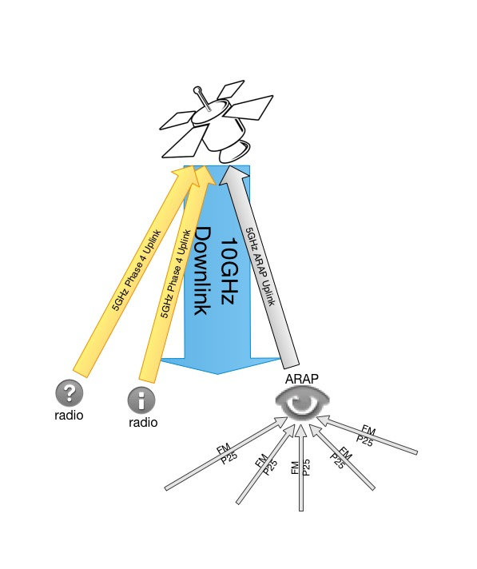
Phase 4 radios
5.645-5.655 GHz up
10.45-10.46 GHz down
Notes:
What about legacy signals?

Slide 7
LDPC - A Compelling History
Discovered in 1963 by Robert Gallagher.
Impractical to implement. Promptly “lost”.
Interpreted in graphical form by Michael Tanner in 1981. We use Tanner Graphs today.
Still impractical to implement. “Lost” again.
Revived by Sir David MacKay in 1996 in a paper.
Chosen for DVB-S2 standard in 2003.
Since then, LDPC has surpassed Turbo codes in error floor and performance, especially at higher code rates. Huge area of academic research in FEC.
Notes:
Gallagher coded this up and ran it an IBM 7090 in 1963. Block length was 500. It was simulated with large probability of error, using all zero codeword only, still took hours.

Slide 8
How Good are LDPC codes?
“Long LDPC codes with iterative decoding based on belief propagation are a fraction of a dB from the Shannon limit.” Implementable decoders!
LDPC codes don’t need interleavers at all or trellis on decode. Parallelizable decoders!
They have great block error and burst error performance.
Error floors occur at lower bit error rates.
Decoding complexity increases linearly with the number of entries (number of 1s) in the parity check matrix. Keep it low!
Single code good for many channel models.
Notes:
“The thought is the language, as Wittgenstein has put it. A technical vocabulary is merely a language within a language. A consideration of this technical vocabulary will be at the same time an attempt to discover the reality which the words disclose or reveal” R.D. Laing The Divided Self p 19

Slide 9
In Phase 4 Ground ACM!
DVB-S2/X has something called ACM.
Adaptive Coding and Modulation lets you adjust to changing signal-to-noise ratios on a per-frame basis.
Best possible throughput for the channel conditions with the radio you have.

Slide 10
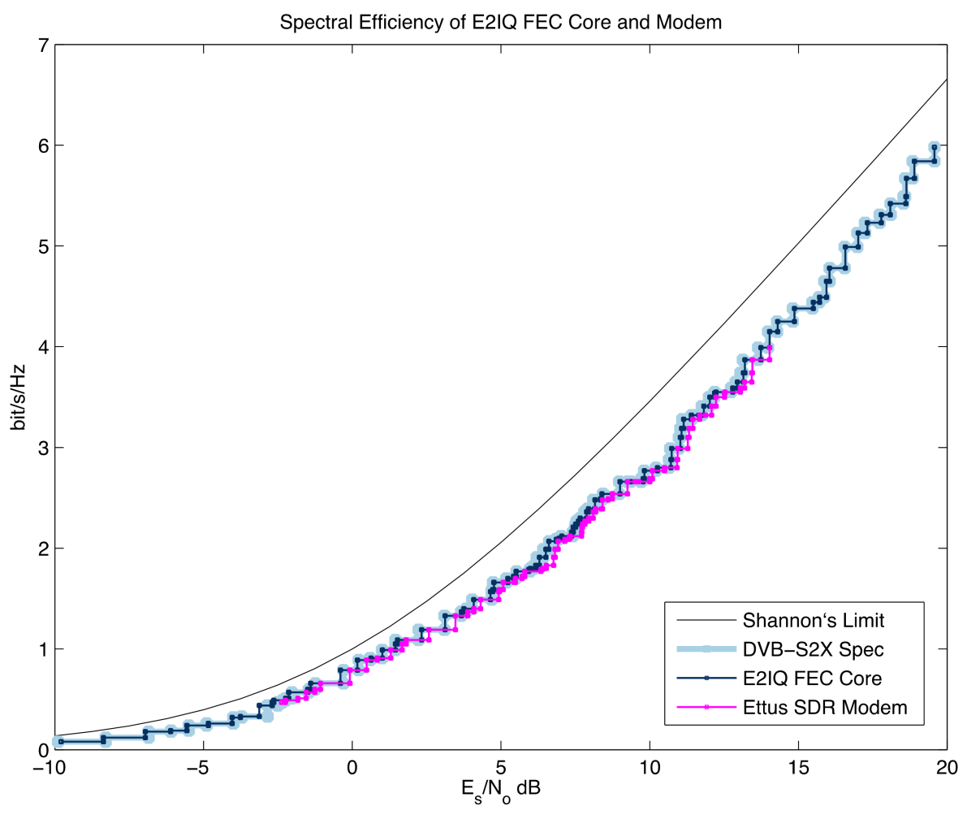
Why Use ACM?
The One True Slide

Slide 12



Slide 13
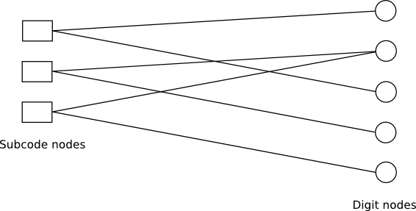
(Michael) Tanner Graphs!
Notes:
In general this is what a Tanner Graph looks like.
It’s called a bipartite graph.
This is what we are dealing with.
First we get our sparse H to look like this,
and then we use this as a map to come up with the math
To do the iterative receiving.
Summary:
We receive a codeword.
We decide what we think we received, as a probability.
We pass that to the parity check nodes.
We process the various combinations. We feed the resulting probabilities back to the nodes holding the bits.
They process some more. They feed probabilities back to the check nodes.
And so on until either we are sure of what we have or what we have corrected, or we have run out of allowed iterations.

Slide 14
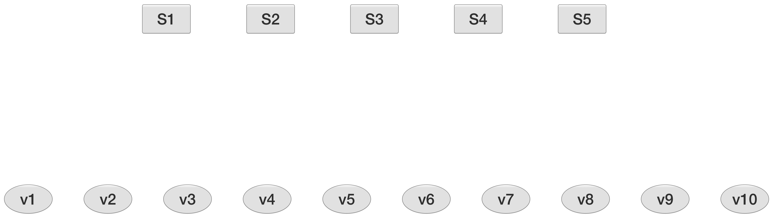
H =
1 1 1 1 0 0 0 0 0 0
1 0 0 0 1 1 1 0 0 0
0 1 0 0 1 0 0 1 1 0
0 0 1 0 0 1 0 1 0 1
0 0 0 1 0 0 1 0 1 1
J rows = J check nodes (J parity check sums) n columns = n variable nodes (n bits in a codeword)

Slide 15
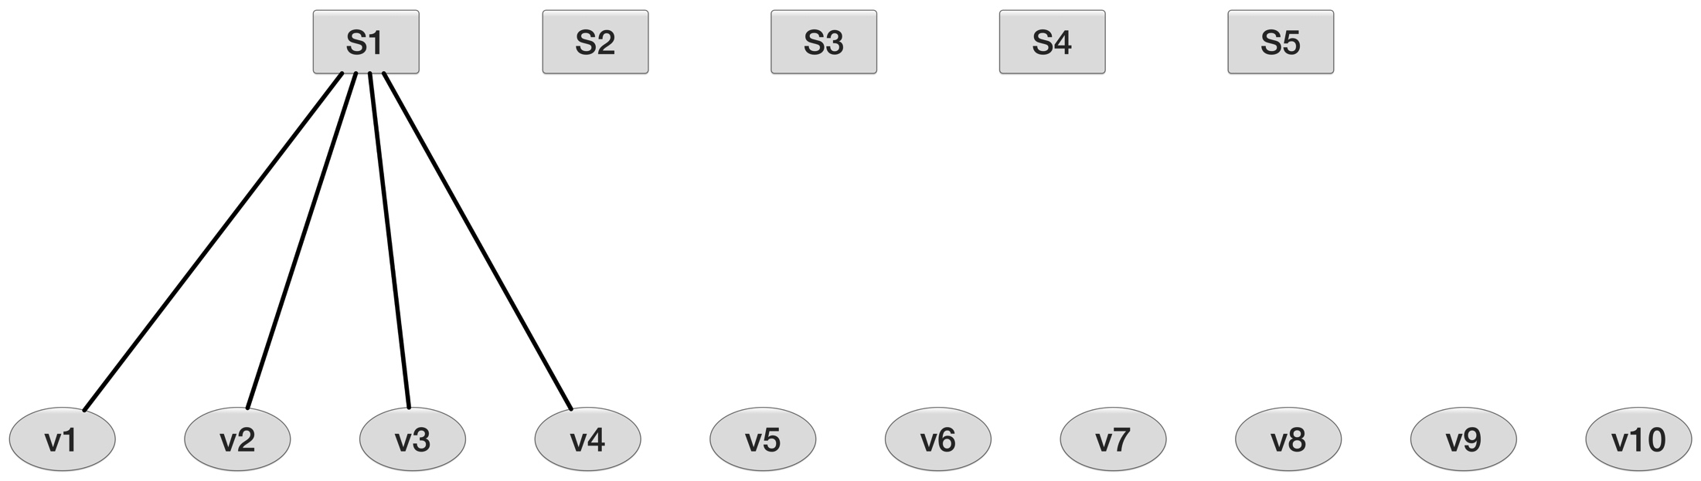
H =
1 1 1 1 0 0 0 0 0 0
1 0 0 0 1 1 1 0 0 0
0 1 0 0 1 0 0 1 1 0
0 0 1 0 0 1 0 1 0 1
0 0 0 1 0 0 1 0 1 1

Slide 16
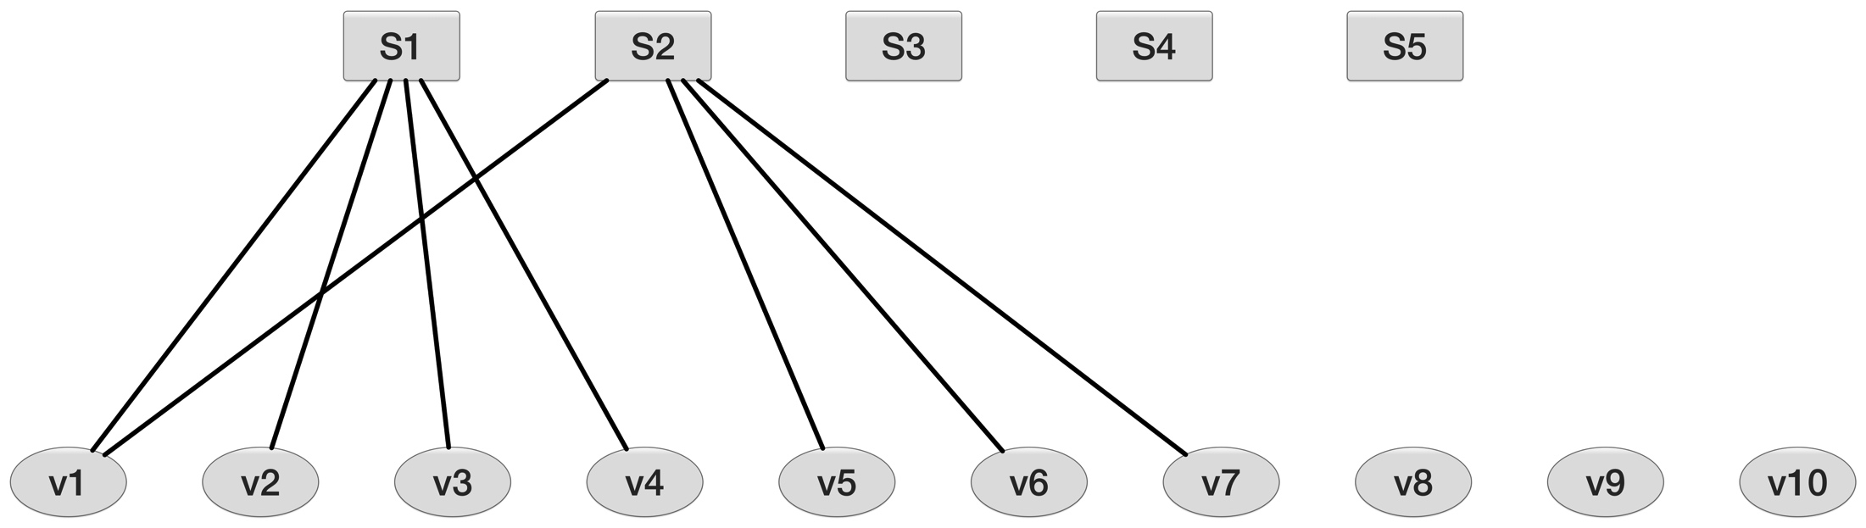
H =
1 1 1 1 0 0 0 0 0 0
1 0 0 0 1 1 1 0 0 0
0 1 0 0 1 0 0 1 1 0
0 0 1 0 0 1 0 1 0 1
0 0 0 1 0 0 1 0 1 1

Slide 17
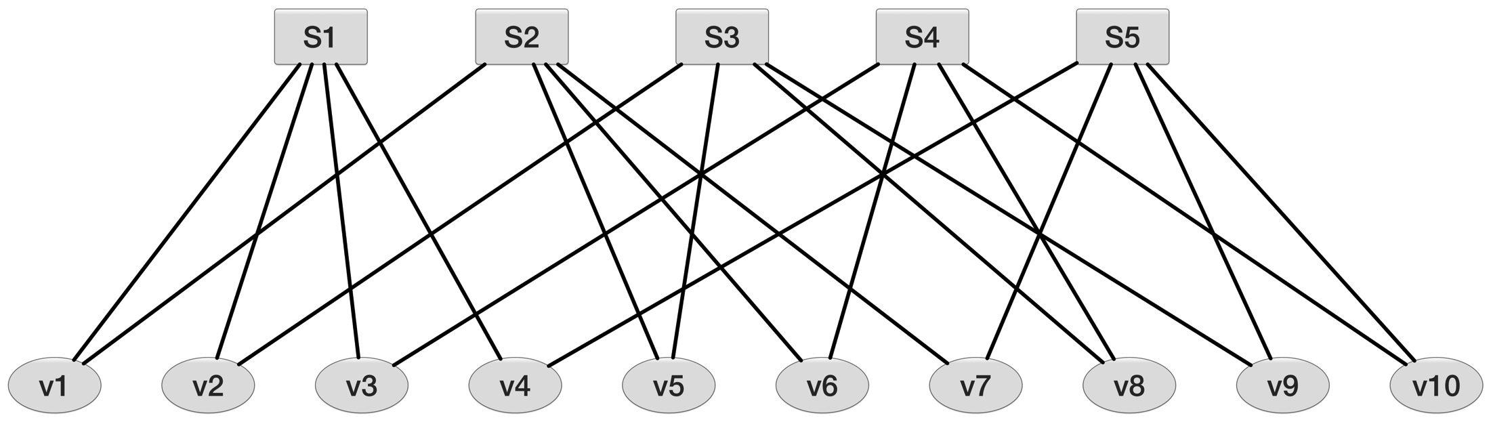
H =
1 1 1 1 0 0 0 0 0 0
1 0 0 0 1 1 1 0 0 0
0 1 0 0 1 0 0 1 1 0
0 0 1 0 0 1 0 1 0 1
0 0 0 1 0 0 1 0 1 1

Slide 18
Are you Regular?
A regular code means the number of 1s is constant for all rows, and constant for all columns. All code bits are involved in the same number of of parity checks, each parity check has the same number of code bits coming in.
But being irregular gives advantages!

Slide 19
H =
1 1 1 1 0 0 0 0 0 0
1 0 0 0 1 1 1 0 0 0
0 1 0 0 1 0 0 1 1 0
0 0 1 0 0 1 0 1 0 1
0 0 0 1 0 0 1 0 1 1
-1 is data 0, 1 is 1.
-1.1 -1.2 -0.9 0.3 -0.8 -1.5 -1.1 -1.2 -0.2 -1.1
Notes:
Hey look! Data!

Slide 20
H =
1 1 1 1 0 0 0 0 0 0
1 0 0 0 1 1 1 0 0 0
0 1 0 0 1 0 0 1 1 0
0 0 1 0 0 1 0 1 0 1
0 0 0 1 0 0 1 0 1 1
LLR for v_{i} = 2*r_{i} / sigma²
(sigma is the noise variance computed from the received SNR. It’s determined by channel conditions.)
^{Here, let’s set sigma = 0.1}
-1.1 -1.2 -0.9 0.3 -0.8 -1.5 -1.1 -1.2 -0.2 -1.1
Notes:
We need some initial probabilities to kick things off.
For AWGN, the LLR for bit being 1 is 2*received value/noise sigma squared. We will use 0.1.

Slide 21
H =
1 1 1 1 0 0 0 0 0 0
1 0 0 0 1 1 1 0 0 0
0 1 0 0 1 0 0 1 1 0
0 0 1 0 0 1 0 1 0 1
0 0 0 1 0 0 1 0 1 1
LLR for v_{i} = 2*r_{i} / sigma²
(sigma is the noise variance computed from the received SNR. It’s determined by channel conditions.)
-220 -240 -180 60 -160 -300 -220 -240 -40 -220
-1.1 -1.2 -0.9 0.3 -0.8 -1.5 -1.1 -1.2 -0.2 -1.1
Notes:
“How sure are we, given what we know the channel is up to, about our received bits? Before we do anything else.

Slide 22
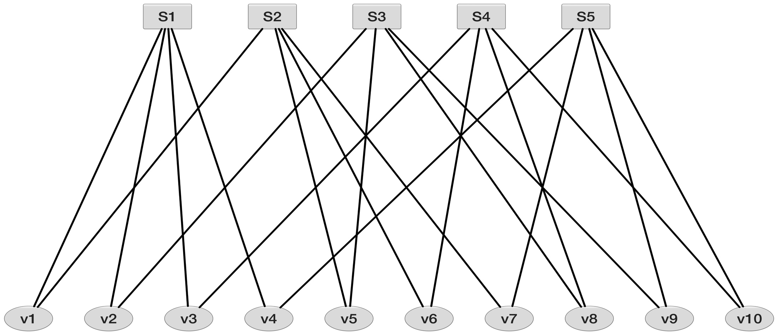
H =
1 1 1 1 0 0 0 0 0 0
1 0 0 0 1 1 1 0 0 0
0 1 0 0 1 0 0 1 1 0
0 0 1 0 0 1 0 1 0 1
0 0 0 1 0 0 1 0 1 1
-220 -240 -180 60 -160 -300 -220 -240 -40 -220
-1.1 -1.2 -0.9 0.3 -0.8 -1.5 -1.1 -1.2 -0.2 -1.1
Notes:
“How sure are we, given what we know the channel is up to, about our received bits? Before we do anything else.

Slide 23
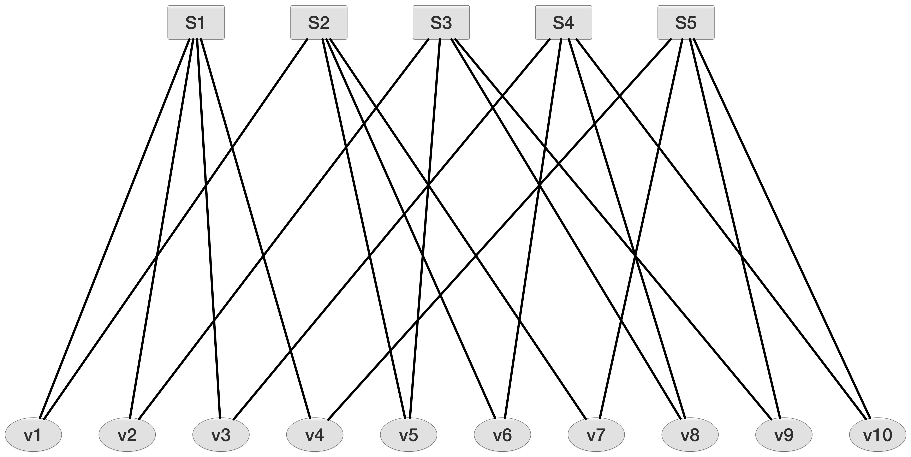
It’s a 0
0.88 0.96 0.72 0.26 0.64 1.0 0.88 0.96 0.56 0.88
-220 -240 -180 60 -160 -300 -220 -240 -40 -220
-1.1 -1.2 -0.9 0.3 -0.8 -1.5 -1.1 -1.2 -0.2 -1.1
Notes:
Number formats and multiplication vs. addition

Slide 24
It’s a 1
It’s a 0
0.12 0.04 0.28 0.59 0.36 0.0 0.12 0.04 0.44 0.12
0.88 0.96 0.72 0.41 0.64 1.0 0.88 0.96 0.52 0.88
-220 -240 -180 60 -160 -300 -220 -240 -40 -220
-1.1 -1.2 -0.9 0.3 -0.8 -1.5 -1.1 -1.2 -0.2 -1.1
Notes:
Probabilities have to add to 1

Slide 25
It’s a 1
It’s a 0
0.12 0.04 0.28 0.59 0.36 0.0 0.12 0.04 0.44 0.12
0.88 0.96 0.72 0.41 0.64 1.0 0.88 0.96 0.52 0.88
-220 -240 -180 60 -160 -300 -220 -240 -40 -220
-1.1 -1.2 -0.9 0.3 -0.8 -1.5 -1.1 -1.2 -0.2 -1.1
Notes:
Number formats and multiplication vs. addition

Slide 26
It’s a 1
It’s a 0
0.12 0.04 0.28 0.59 0.36 0.0 0.12 0.04 0.44 0.12
0.88 0.96 0.72 0.41 0.64 1.0 0.88 0.96 0.52 0.88
For each bit node we now have a probability it’s a -1 and the probability that it is a 1. The two probabilities add to a total of 1. -1 is data 0, 1 is 1.
Notes:
Number formats and multiplication vs. addition

Slide 27
We send these probabilities to the check sum nodes!
0.12 0.04 0.28 0.59 0.36 0.0 0.12 0.04 0.44 0.12
0.88 0.96 0.72 0.41 0.64 1.0 0.88 0.96 0.52 0.88
Notes:
Number formats and multiplication vs. addition

Slide 28
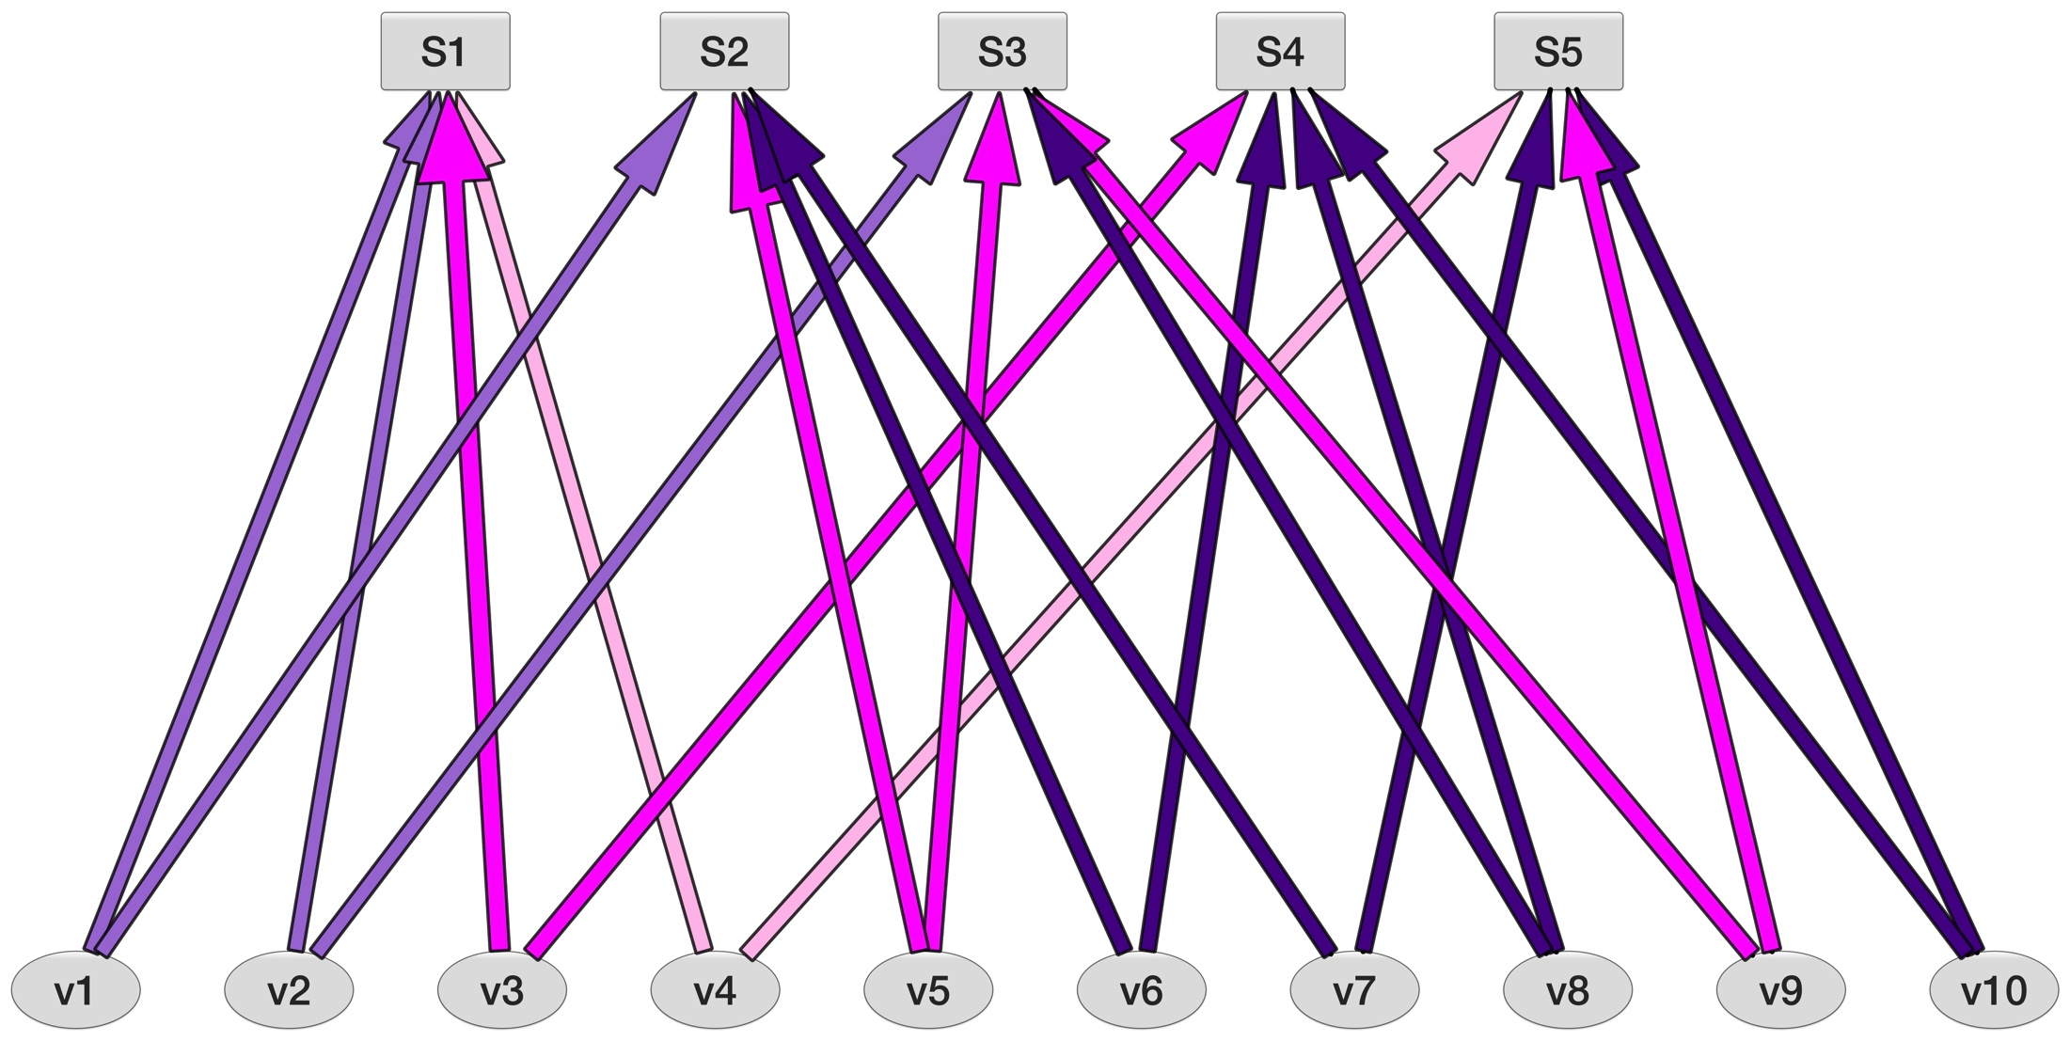
We send these probabilities to the check sum nodes!
0.12 0.04 0.28 0.59 0.36 0.0 0.12 0.04 0.44 0.12
0.88 0.96 0.72 0.41 0.64 1.0 0.88 0.96 0.52 0.88
Notes:
Number formats and multiplication vs. addition

Slide 29
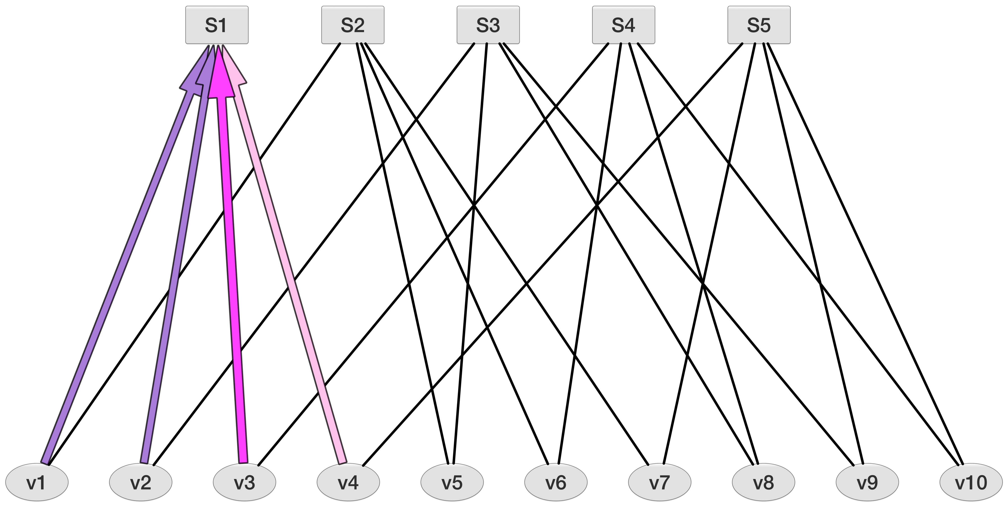
We send these probabilities to the check sum nodes!
0.12 0.04 0.28 0.59 0.36 0.0 0.12 0.04 0.44 0.12
0.88 0.96 0.72 0.41 0.64 1.0 0.88 0.96 0.52 0.88
Notes:
Number formats and multiplication vs. addition

Slide 30
Now we do some work in the check sum nodes.
Each node is one row of the parity check matrix H.
0.12 0.04 0.28 0.59 0.36 0.0 0.12 0.04 0.44 0.12
0.88 0.96 0.72 0.41 0.64 1.0 0.88 0.96 0.52 0.88
Notes:
Number formats and multiplication vs. addition

Slide 31
Each S node should sum to zero, if the codeword is valid. That takes an even number of 1’s. (0 is an even number)
0.12 0.04 0.28 0.59 0.36 0.0 0.12 0.04 0.44 0.12
0.88 0.96 0.72 0.41 0.64 1.0 0.88 0.96 0.52 0.88
Notes:
Number formats and multiplication vs. addition

Slide 32
Let’s look at S1 to see what we do for this side of the iteration.
0.12 0.04 0.28 0.59 0.36 0.0 0.12 0.04 0.44 0.12
0.88 0.96 0.72 0.41 0.64 1.0 0.88 0.96 0.52 0.88
Notes:
Number formats and multiplication vs. addition

Slide 33
You know how it is.

Slide 34
You have an even # of children.

Slide 35
And one doesn’t cooperate.

Slide 36
S1 tells each bit node how probable it is that they’re a 1.
It’s like a parent telling each child what the other children think of them, and maybe how they should change.
0.12 0.04 0.28 0.59 0.36 0.0 0.12 0.04 0.44 0.12
0.88 0.96 0.72 0.41 0.64 1.0 0.88 0.96 0.52 0.88
Notes:
Number formats and multiplication vs. addition

Slide 37
How does this happen?
Hey, variable node 4, let’s assume you’re a 1.
If you’re a 1, then there’s either one more 1 besides you, or there are three other 1s. You’re all 1s.
You can’t be the only 1.
We can’t have you be 1, and two others be 1. That would be three 1s.

Slide 38
Written out in Math
p(v₄=1) = p(v₁)*(1-p(v₂))*(1-p(v₃)) +
p(v₂)*(1-p(v₁))*(1-p(v₃)) +
p(v₃)*(1-p(v₁))*(1-p(v₂)) +
p(v₁)*p(v₂)*p(v₃)

Slide 39
Written out in Math
p(v₄=1) = p(v₁)*(1-p(v₂))*(1-p(v₃)) +
p(v₂)*(1-p(v₁))*(1-p(v₃)) +
p(v₃)*(1-p(v₁))*(1-p(v₂)) +
p(v₁)*p(v₂)*p(v₃)
Likelihood of v_{i} being equal to data 1

Slide 40
Written out in Math
p(v₄=1) = p(v₁)*(1-p(v₂))*(1-p(v₃)) +
p(v₂)*(1-p(v₁))*(1-p(v₃)) +
p(v₃)*(1-p(v₁))*(1-p(v₂)) +
p(v₁)*p(v₂)*p(v₃)
Each bit node gets a message formed from the probabilities from the other snitches. Nodes! Other bit nodes!

Slide 41
You have been weighed.
So our result back to you, node 4, is 0.35
You better shape up
Ooo ooo ooo
Because you need a plan

Slide 42
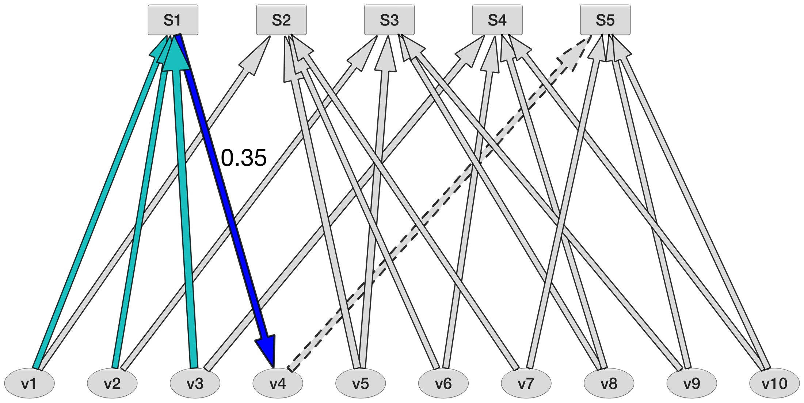
v4 updated from v1, v2, v3
0.12 0.04 0.28 0.59 0.36 0.0 0.12 0.04 0.44 0.12
0.88 0.96 0.72 0.41 0.64 1.0 0.88 0.96 0.52 0.88

Slide 43
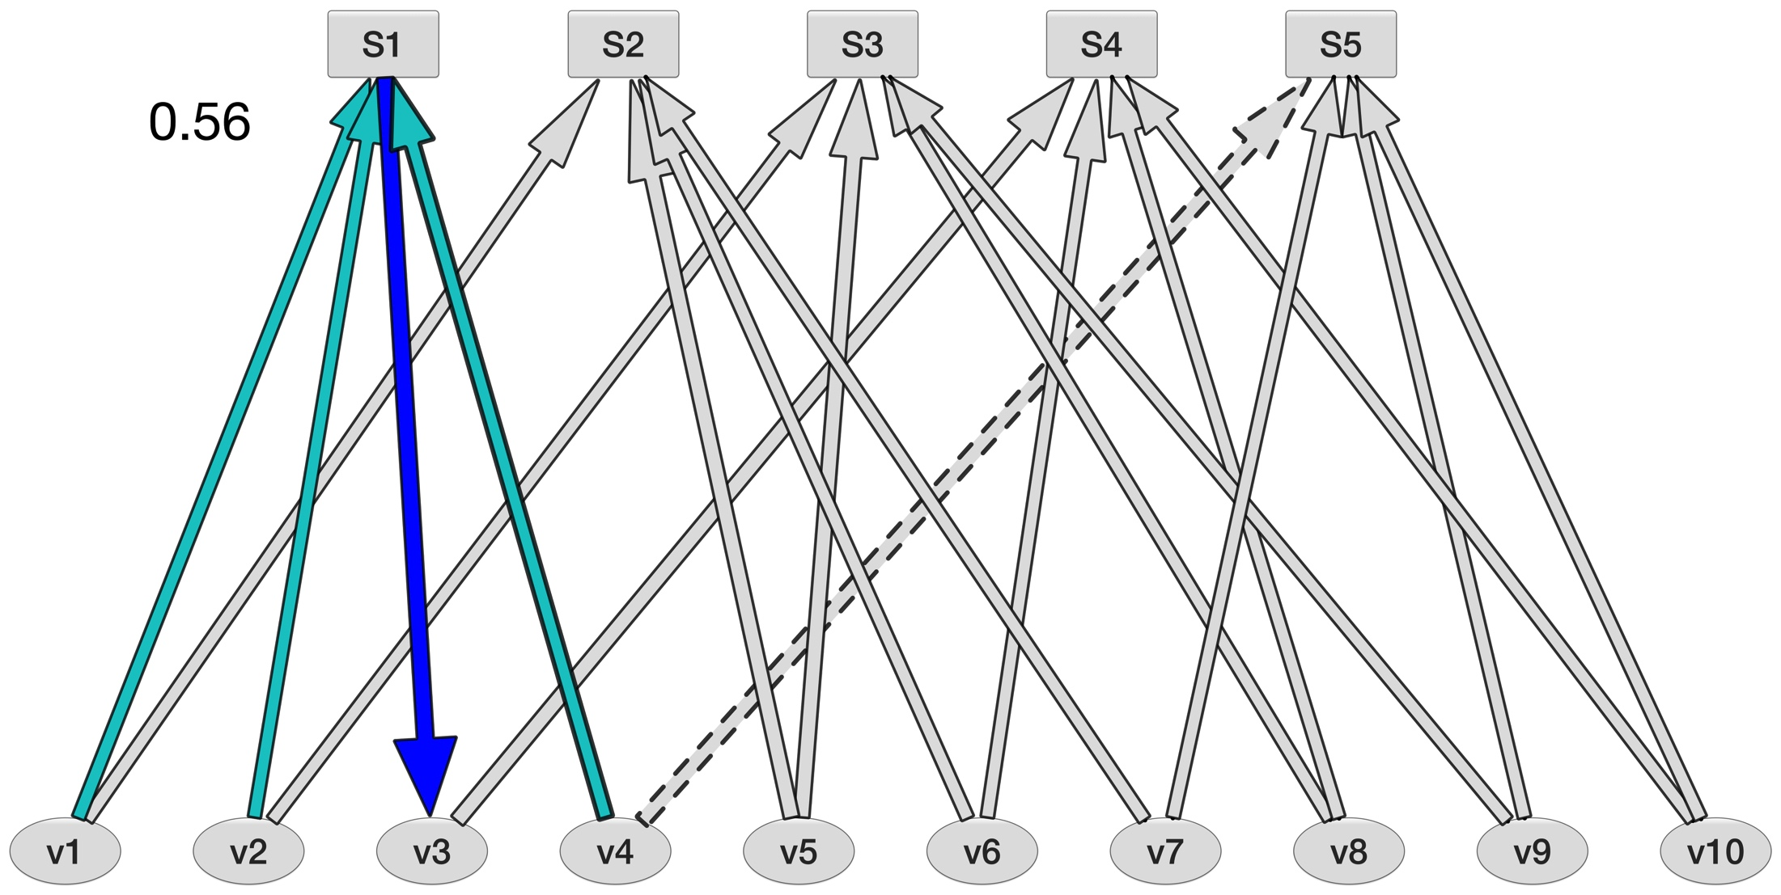
v3 updated from v1, v2, v4
0.12 0.04 0.28 0.59 0.36 0.0 0.12 0.04 0.44 0.12
0.88 0.96 0.72 0.41 0.64 1.0 0.88 0.96 0.52 0.88

Slide 44
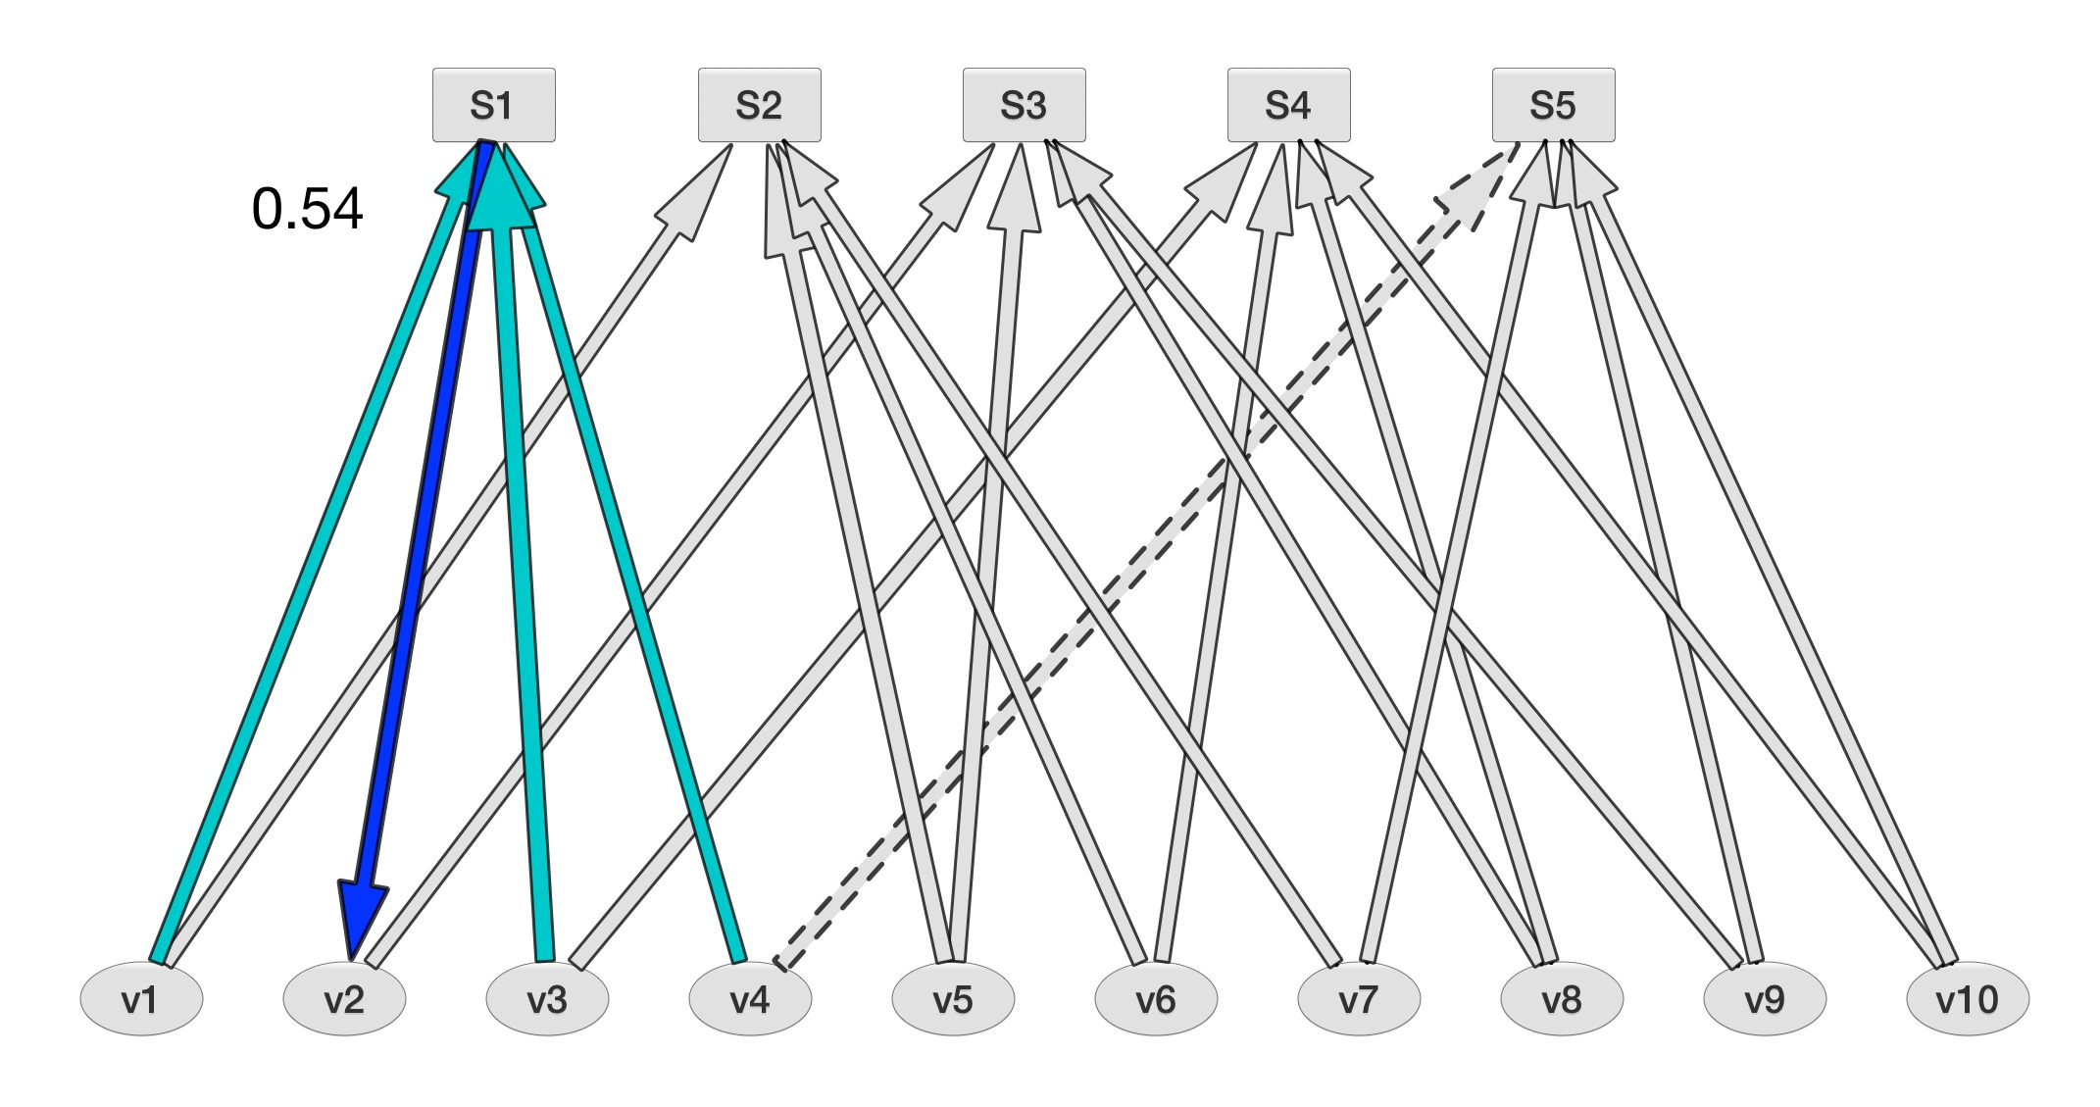
v2 updated from v1, v4, v3
0.12 0.04 0.28 0.59 0.36 0.0 0.12 0.04 0.44 0.12
0.88 0.96 0.72 0.41 0.64 1.0 0.88 0.96 0.52 0.88

Slide 45
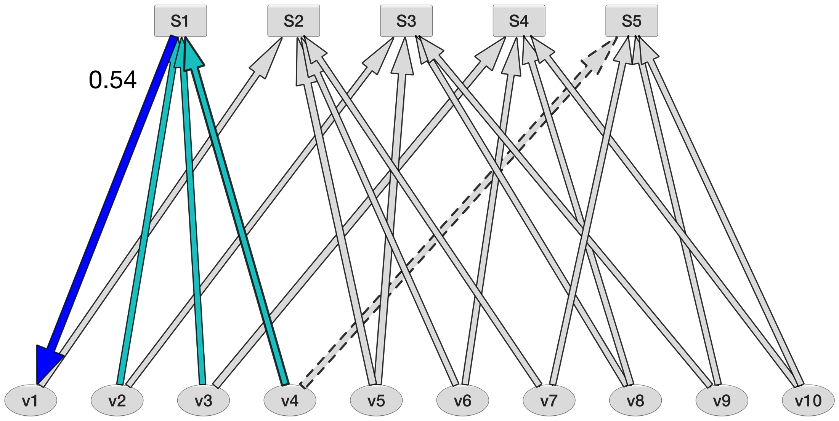
v1 updated from v4, v2, v3
0.12 0.04 0.28 0.59 0.36 0.0 0.12 0.04 0.44 0.12
0.88 0.96 0.72 0.41 0.64 1.0 0.88 0.96 0.52 0.88

Slide 46
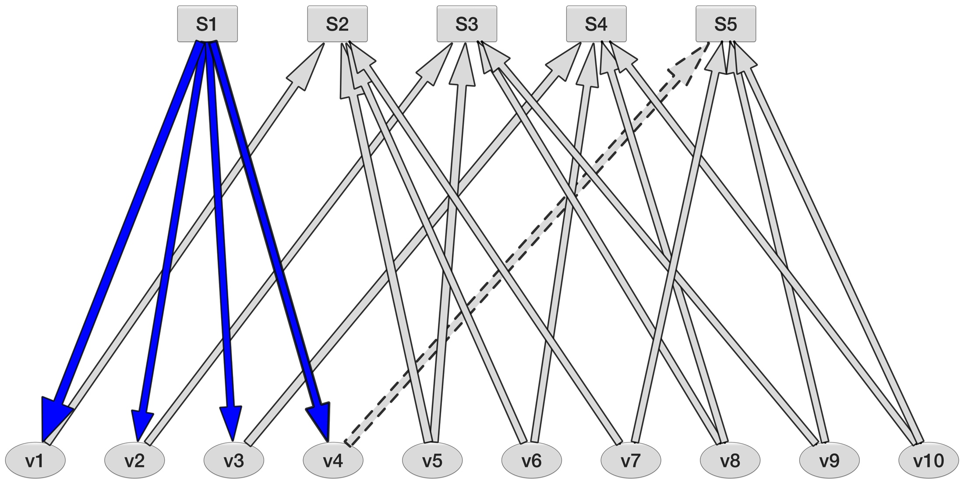
Bit nodes likelihoods updated.
0.54 0.54 0.56 0.34
0.12 0.04 0.28 0.59 0.36 0.0 0.12 0.04 0.44 0.12
0.88 0.96 0.72 0.41 0.64 1.0 0.88 0.96 0.52 0.88

Slide 47
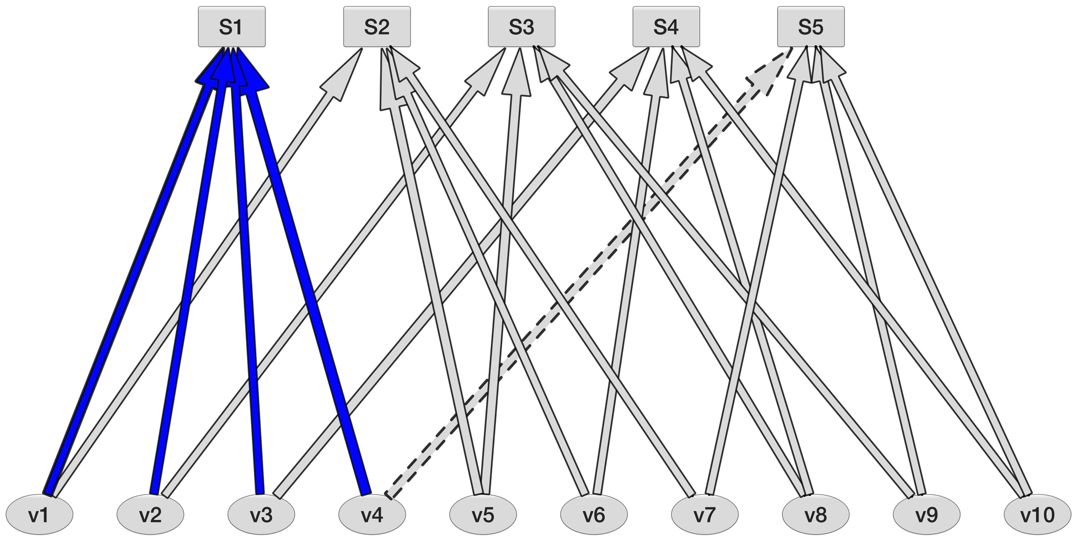
The Real power is the cross connections.
0.54 0.54 0.56 0.34
0.12 0.04 0.28 0.59 0.36 0.0 0.12 0.04 0.44 0.12
0.88 0.96 0.72 0.41 0.64 1.0 0.88 0.96 0.52 0.88
Notes:
These cross connections work in parallel. It’s not just one set of siblings that are on to you. You can try and pass off your bad behavior in another group, but it’s not going to work there either.

Slide 48
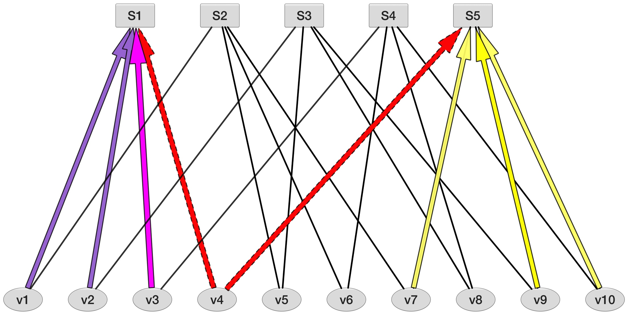
The Real power is the cross connections.
0.54 0.54 0.56 0.34
0.12 0.04 0.28 0.59 0.36 0.0 0.12 0.04 0.44 0.12
0.88 0.96 0.72 0.41 0.64 1.0 0.88 0.96 0.52 0.88
Notes:
Here are the parity check equations that v4 is involved in, and all the siblings that will rat on you.
It’s not just one family you’re pissing off.

Slide 49
Next, we send updated probabilities back.
0.54 0.54 0.56 0.34
0.12 0.04 0.28 0.59 0.36 0.0 0.12 0.04 0.44 0.12
0.88 0.96 0.72 0.41 0.64 1.0 0.88 0.96 0.52 0.88

Slide 50
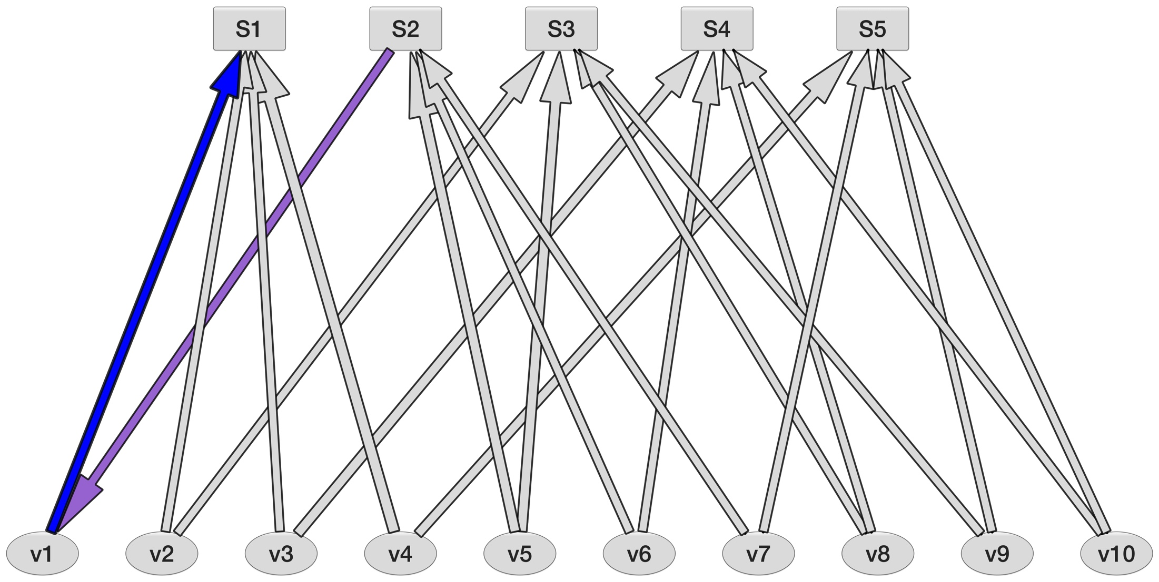
Hey look, info from other check nodes…
0.67 0.66 0.59 0.28
0.12 0.04 0.28 0.59 0.36 0.0 0.12 0.04 0.44 0.12
0.88 0.96 0.72 0.41 0.64 1.0 0.88 0.96 0.52 0.88

Slide 51
V1=K*LLR channel result*p(a)*p(b)
Now with
vitamin K!
0.67 0.66 0.59 0.28
0.12 0.04 0.28 0.59 0.36 0.0 0.12 0.04 0.44 0.12
0.88 0.96 0.72 0.41 0.64 1.0 0.88 0.96 0.52 0.88

Slide 52
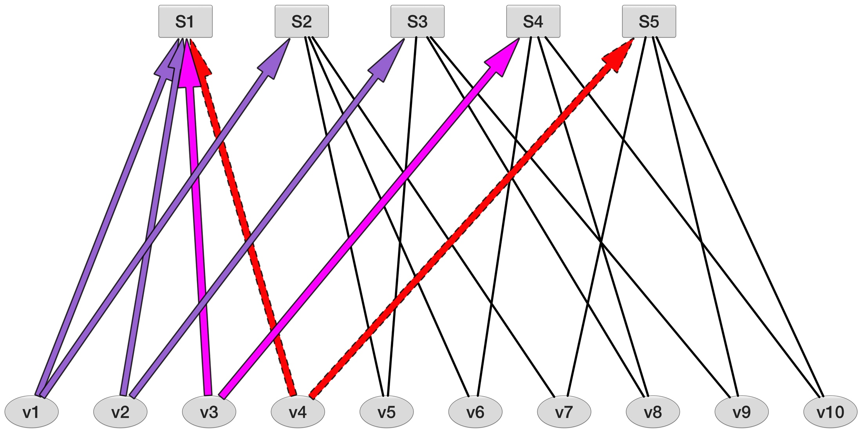
All the parity check nodes affected by v1-v4.
0.67 0.66 0.59 0.28
0.12 0.04 0.28 0.59 0.36 0.0 0.12 0.04 0.44 0.12
0.88 0.96 0.72 0.41 0.64 1.0 0.88 0.96 0.52 0.88

Slide 53
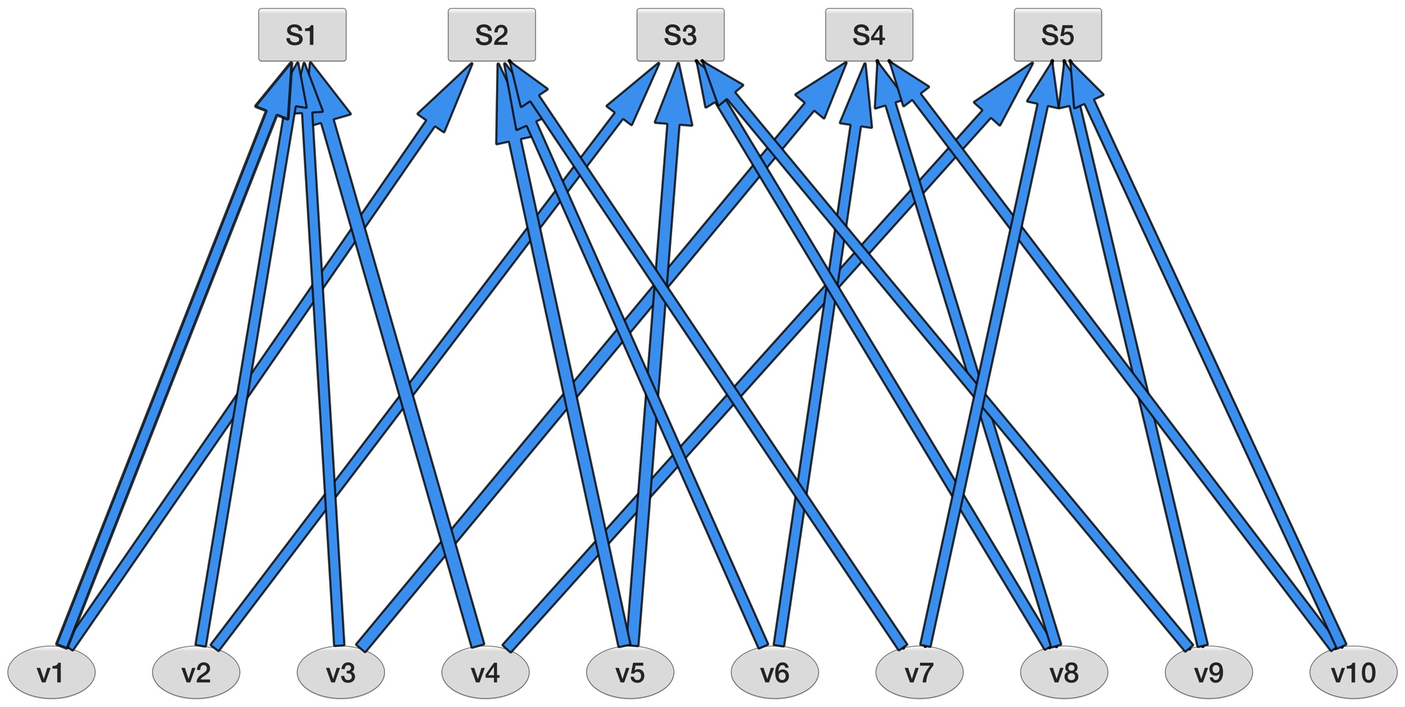
Everyone has snitched.
0.67 0.66 0.59 0.28 0.56 0.92 0.67 0.66 0.53 0.67
0.12 0.04 0.28 0.59 0.36 0.0 0.12 0.04 0.44 0.12
0.88 0.96 0.72 0.41 0.64 1.0 0.88 0.96 0.52 0.88

Slide 54
The beatings will continue
Check node ➔ variable node starts the iteration again.
This back and forth continues until either a threshold probability is reached, or a maximum number of iterations has been reached.
Convergence is an active area of study.

Slide 55

Sierra A

Slide 56
Notes:
Thank you for coming to my TED talk

